Slide 1


ATL- MARATHON
—------------------
DEVELOPMENT
DRINKING WATER &
SANITATION
IDEA BY:
ARNAV VENKATESH ・VIHAAN M SHETTY ・SANAY PAREEK
from N.H.V.P.S, Bengaluru
w/ Rashtrotthana Vidya Kendra, Bengaluru

Slide 2

NECESSITY is the MOTHER of INVENTION

Slide 3
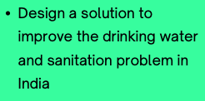
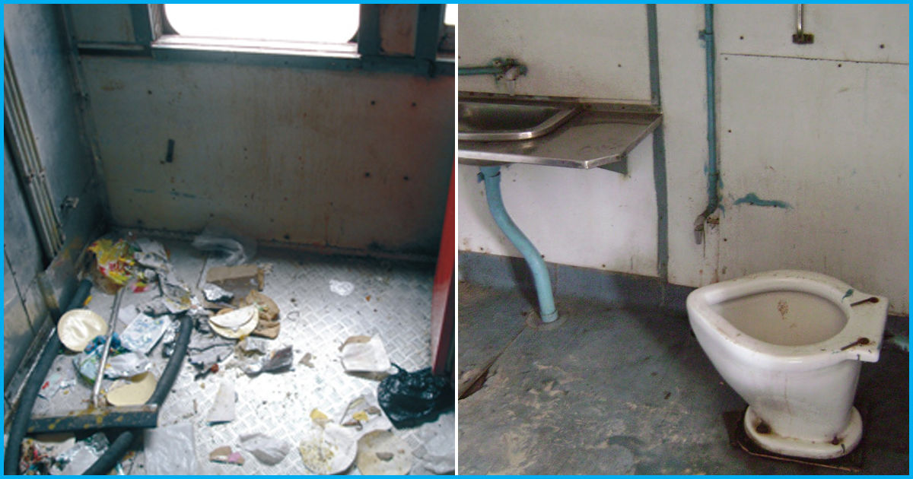
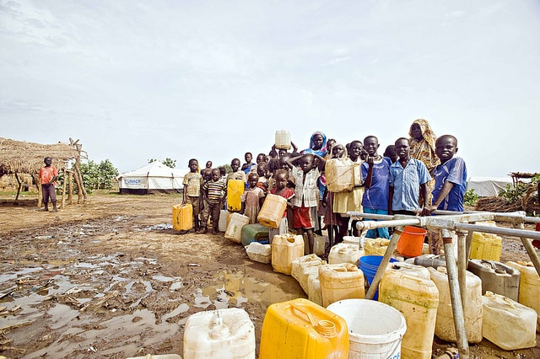
The problem and the goal:
Let’s face it. Though India is one of the greatest countries, it has water and sanitation problems. We have shortage of water, unclean water, unhygienic railway toilets among others.
BUT WAIT! WE HAVE A SOLUTION!!
To improve sanitation problems, we need to to encourage private entrepreneurs to take up water purification. But with shortage of water, that’s going nowhere.
So here we have our solution to both obtain more water and make it drinkable almost instantly!
And we have an amazing solution to unclean toilets in Railway Stations and trains! Let’s go through them!

Slide 4
01
Drinking
Water
Water shortage and our solution

Slide 5
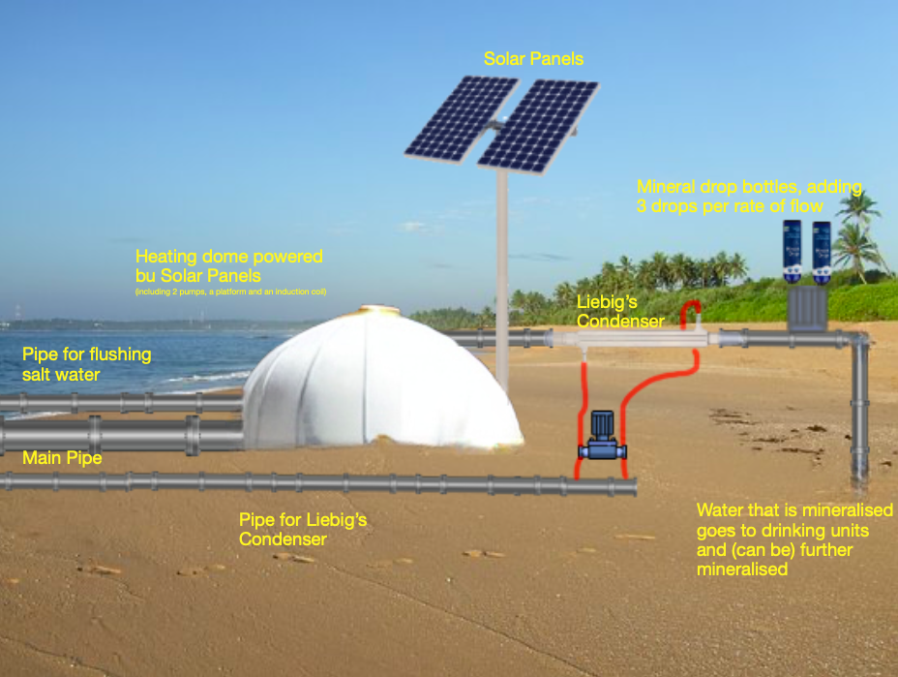
Cheap and effective desalination:
We know that the Earth is covered with 71% of water. But unfortunately, only 1% of it is drinkable. That’s because we can’t drink the saline sea water.
But here we are! —------------------------->
A contraption where sea water is pumped into a heating dome, and a simple solar powered induction coil heats the water. Then, the remaining compound sea water, is flushed back into the sea. However, the heated steam travels into a Liebig’s condenser further to be mineralised by standard Mineral Drops which makes it instantly drinkable or further mineralised.
But why you ask are such facilities not yet built? That’s because of their cost. So here we have a smaller device, with low cost and maintenance to be deployed on the oceans of India

Slide 6
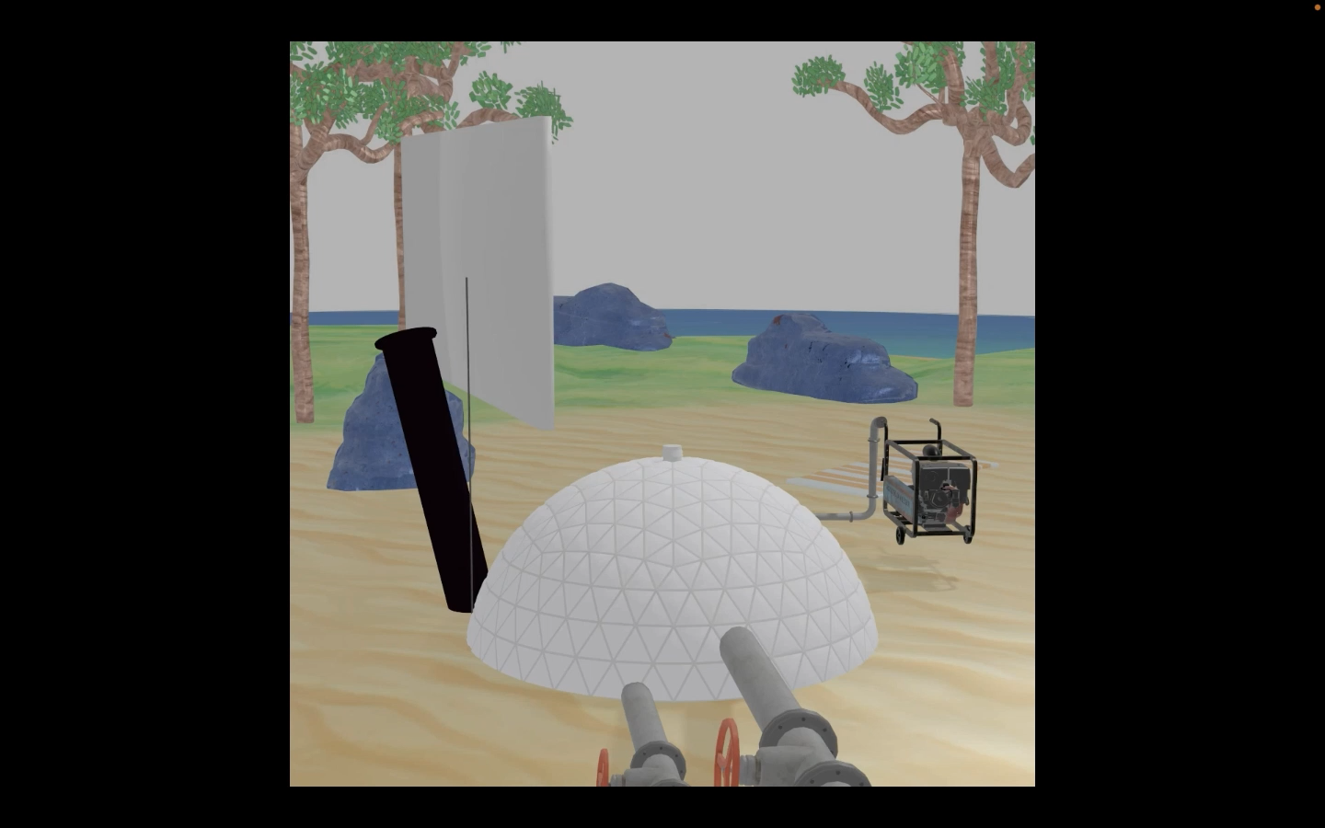
Our 3D Model:
3D model by Vihaan M. Shetty

Slide 7
02
Toilet
Sanitation
The Railway sanitation and our solution

Slide 8


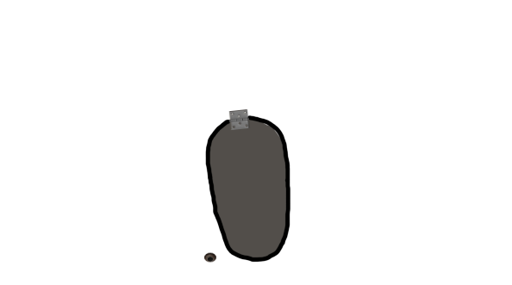

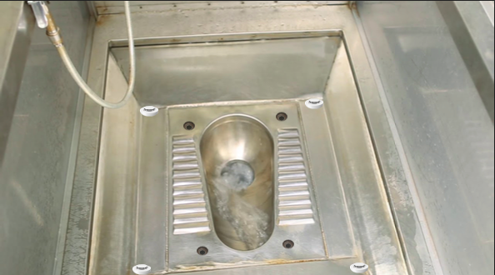
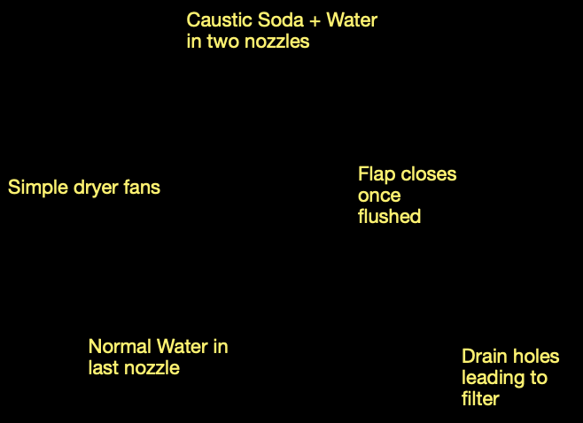
E-Toilets - But way better!
Let’s face it. Railway toilets are not as clean as we want them to be. Despite the efforts of the government, our toilets remain to be unclean. So here’s our solution.
An EToilet is good, but very costly. So we’ve taken an EToilet and ripped apart everything except the structure. Once the person exits, the commode flushes itself.
But here’s the catch, there are 4 nozzles in the corners of the room and they spray jets of caustic soda mixed with water around it. All the solid excreta is dissolved and pushed into the commode. Now the flap closes.
To further sanitise the toilet and clear the smells, the nozzles begin to spray normal water everywhere for almost 8 seconds. This goes into 4 small drain holes near the commode and further into a filter (next slide)
There are simple DC motor run fans, next to the commode which dries the place and prepares for the next person in less than 15 seconds!

Slide 9
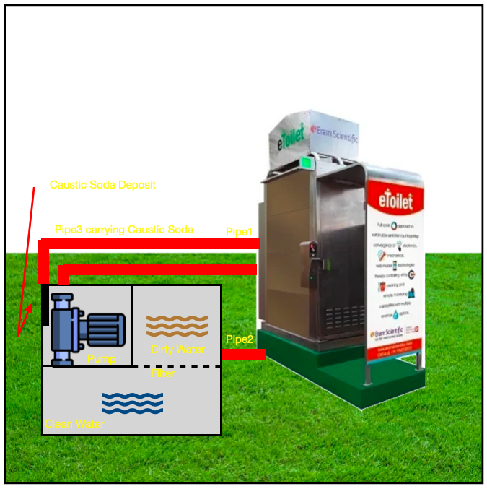
How we save water:
As we mentioned, EToilets are neither cost effective nor do they recycle the water as good as this:
Once the small drains collect the dirty water it is passed into a pipe leading to a filtering unit. In the case of trains, half a carriage can be dedicated to this unit.
The unit has a disposable filter (which needs to be replaced at least a month). It makes the water clear and further passes it into a pump.
Now the pump has two outlets, one that mixes the water with caustic soda (2 drops per rate of flow) and the other just normal water.
This water is reused again and again, till the toilet goes through a maintenance check, once a month.
No more cleaning the toilet! Just once a month!

Slide 10
THANK YOU
We hope we can create an impact in the society.

